Slide 1
FTP
Computer Network
Project 1

Slide 2
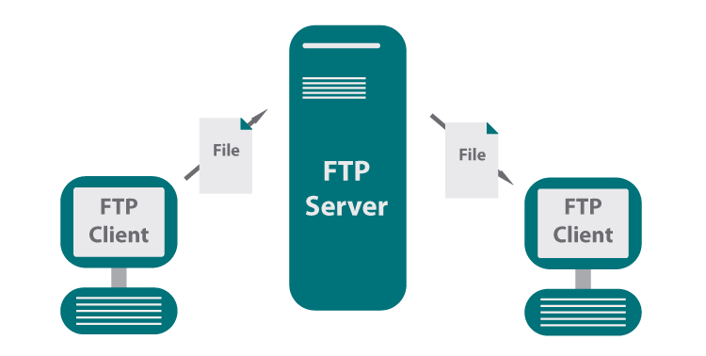



What is FTP?
Application layer protocols: SSH, P2P, FTP, etc.
A protocol used for file download or upload between server and client.
SSH
P2P

Slide 3

How to implement an FTP?
Open computer;
Write code;
Run code;
Is that so?

Slide 4
Socket Programming

Slide 5
What is Socket?
Socket is an API to use internet resources.
Host-local, application-created, OS-controlled interface.
controlled by
application
developer
process
process
socket
socket
Network
resources
Network
resources
controlled by
operating
system
Internet
host or
server
host or
server

Slide 6
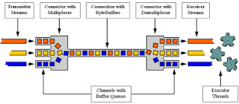
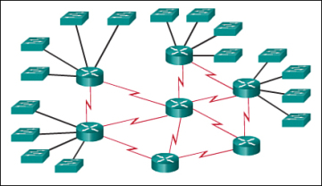
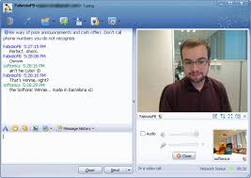


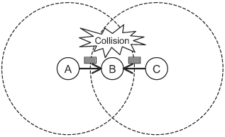
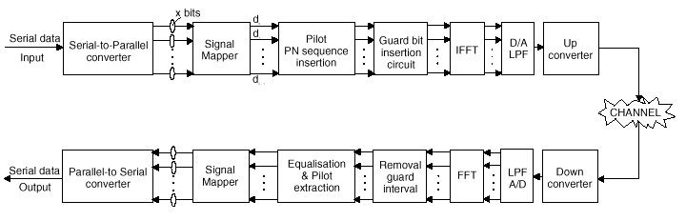
Why do we need socket?
Layering

Slide 7
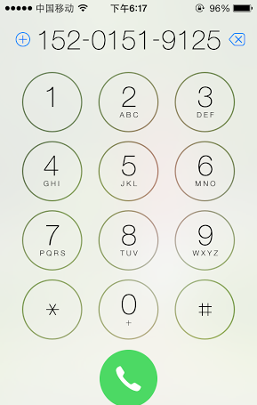
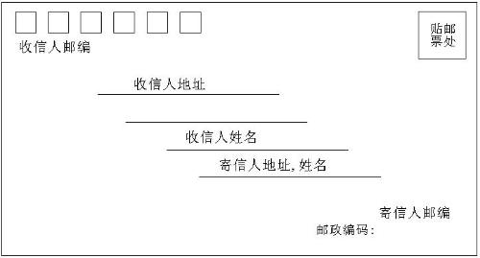
Socket Identification
Mail | Call | Socket
Your Address | Your Phone Num. | Local Socket Address
Her Address | Her Phone Num. | Remote Socket Address
Envelop | Radio | Protocol
Socket?

Slide 8
Address
The address must identify the sender/receiver.
Identification of the host – IP Address
IPv4: 32bit, X.X.X.X, X:8 bit
IPv6: 128bit, Y:Y:Y:Y:Y:Y:Y:Y, Y:16 bit
Identification of the process – Port
0~65535
The five tuples to specify a socket:
(SrcIP, SrcPort, DstIP, DstPort, Protocol)

Slide 9
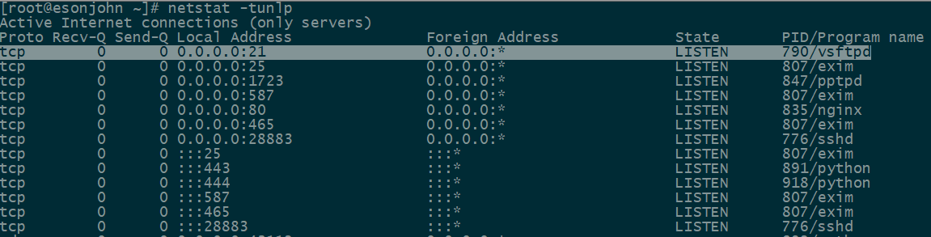
Port Usage
Popular applications have “well-known ports”.
By convention, between 0 and 1023; privileged
E.g., port 80 for HTTP, 25/465 for SMTP, 21 for FTP
For more, refer to Wikipedia.
Custom client gets an unused “ephemeral” port.
By convention, between 1024 and 65535.

Slide 10
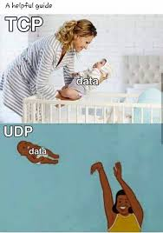
Transport Layer Protocol
Socket at Transport Layer.
TCP
Connection-oriented protocol
Reliable, ordered, heavyweight and streaming
UDP
Connectionless protocol
Unreliable, not ordered, lightweight and datagrams
Fly b*tch

Slide 11
Socket Programming in C
Client
Server
❍
socket
socket

bind

TCP only
listen
●
Connection Request
■
connect
accept
□
❐
write
read
❑
⬧
read
write
❒
Waiting for next
connection Request
EOF
close
read
close

Slide 12
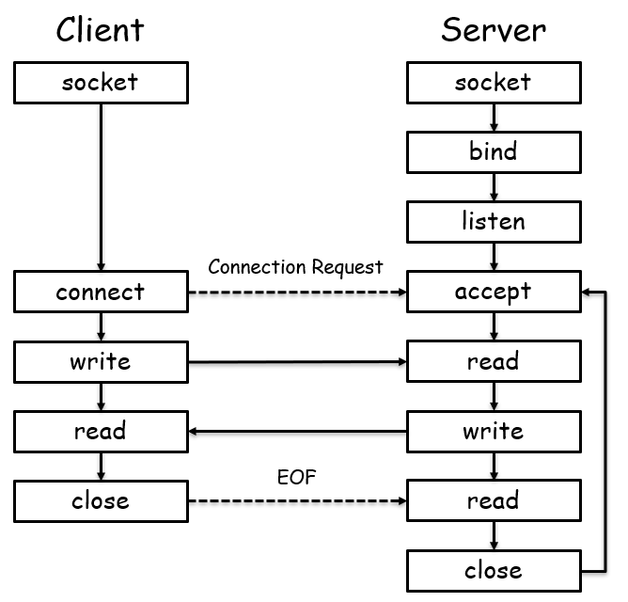
API Functions
Create a socket
int socket(int domain, int type, int protocol)
Domain: ipv4/ipv6
Type: SOCK_STREAM/SOCK_SEQPACKET/…
Protocol: TCP/UDP/…

Slide 13
API Functions
Server listening
Bind some port
int bind (int sockfd, struct sockaddr *my_addr, int addrlen)
sockfd: socket handler
my_addr: local listening address
addrlen: my_addr length
Define how many connections can be pending
int listen(int sockfd, int backlog)
sockfd: socket handler
backlog: maximum connections
Accept a new connection from a client
int accept(int sockfd, struct sockaddr *addr, int *addrlen)
sockfd: socket handler
addr: client address
addrlen: addr length

Slide 14
API Functions
Establish a connection
int connect(int sockfd, struct sockaddr *serv_addr, int addrlen)
sockfd: socket handler
serv_addr: server address
addrlen: serv_addr length

Slide 15
API Functions
For TCP, Send Data
ssize_t write(int sockfd, const void *buf, size_t nbytes);
ssize_t send(int sockfd, const void *buf, size_t nbytes, int flags);
sockfd: socket handler
buf: data buffer
nbytes: write/send data length
flags: block/nonblock/…
For TCP, Receive Data
ssize_t read(int sockfd, void *buff, size_t nbytes);
ssize_t recv(int sockfd, void *buff, size_t nbytes, int flags);
For UDP, use
ssize_t sendto (int sockfd, void *buff, size_t nbytes, int flags, const struct sockaddr *dest_addr, int addrlen);
ssize_t recvfrom (int sockfd, void *buff, size_t nbytes, int flags, const struct sockaddr *src_addr, int addrlen);

Slide 16
API Functions
Byte Ordering
unsigned long int htonl(unsigned long int hostlong)
unsigned short int htons(unsigned short int hostshort)
unsigned long int ntohl(unsigned long int netlong)
unsigned short int ntohs(unsigned short int netshort)
IP Addresses
int inet_aton(const char *cp, struct in_addr *inp)
char *inet_ntoa(struct in_addr in);

Slide 17
Other Tools
How to check if particular port is listening
Windows – use netstat
netstat -an
Linux – use nmap
nmap -sT -O localhost
Status code of bind function indicates port usage
Not knowing what exactly gets transmitted on the wire
Use tcpdump or Ethereal (www.ethereal.com)
Check RFC if in doubt about protocols.
RFC 959

Slide 18
Commands in FTP
USER, PASS
login to server
RETR
download file from server
STOR
upload file to server
PORT, PASV
specify active/passive mode
MKD, CWD, PWD, LIST
manipulate directories on server
...(rfc 959)

Slide 19
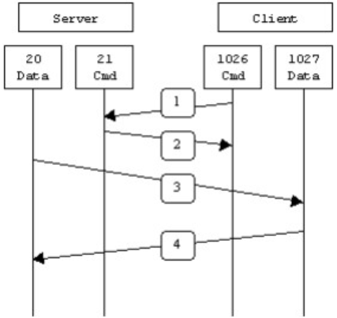
PORT Mode of FTP
PORT(Active Model)
Server monitor default control port 21
Client request control port N1 from OS
Client request data port N2 from OS and notify Server
Server setup connection between local 20 port and client N2 port
Data streams between server 20 port and client N2 port
Data socket
Control socket

Slide 20
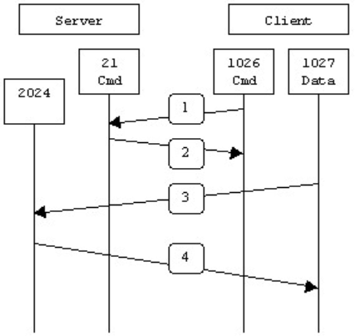
PASV Mode of FTP
PASV(Passive Model)
Server monitor default control port 21
Client request control port N1 from OS
Client request data connection from Server on N1
Server request data port N2 from OS and notify Client
Client request data port N3 from OS
Client setup connection between local port N3 and server port N2
Data streams between server port N2 and client port N3
Data socket
Control socket

Slide 21
PORT vs. PASV
Data socket
Data socket
Control socket
Control socket

Slide 22
Project Description
Goal
Learn to setup communications between PCs with socket.
To be familiar with FTP protocol;
To be familiar with network protocol stack;
Learn to build client/server applications that communicate using sockets.

Slide 23
Task1: UDP Programming
Read the sample code
Choose any language you are familiar with(C, C#, Java, node, Python).
Modify the UDP Server and Client According to the homework guide.
Questions:
How to write a chat programming (two clients chat with each other) with UDP?

Slide 24
Task2: Implementing FTP Server
Stage 1
Must use the Berkeley Socket API (Linux) and write your server in C;
Must serve files from a designated directory on your system to clients making requests on a designated TCP port;
Must handle USER, PASS, QUIT, SYST, TYPE, PORT, PASV, MKD, CWD, PWD, LIST, RMD, RNFR, RNTO commands;

Slide 25
Task2: Implementing FTP Server
Stage 1
Handling invalid input reasonably and generating defensible error codes;
May not use any libraries containing code specifically designed to implement FTP functionality (coding at socket level);

Slide 26
Task2: Implementing FTP Server
Stage 2
Handle RETR and STOR commands to support file transmission;
Support integral large file transmission;
Support connections from multiple clients;
Optional
(5%) Resume transmission after connection terminated;
(5%) File transmission without blocking the server;

Slide 27
Task3: Implementing FTP Client
Stage 1
You can write your client in your favorite programming language;
Must handle USER, PASS, QUIT, SYST, TYPE, PORT, PASV, MKD, CWD, PWD, LIST, RMD, RNFR, RNTO commands;
Able to log in a provided commercial FTP server and download/upload files;

Slide 28
Task3: Implementing FTP Client
Stage 2
Handle RETR and STOR commands to support file transmission;
Support integral large file transmission;
Optional
(5%) Resume transmission after connection terminated;
(5%) Friendly GUI;
(5%) File transmission without blocking the GUI;

Slide 29
Some Important Issues
Grading
UDP Programming (10%)
Implementation of FTP (70%+10%)
Server (40%)
Client (30%)
Optional (5%+5%)
Project Report (20%)
Individual work.

Slide 30
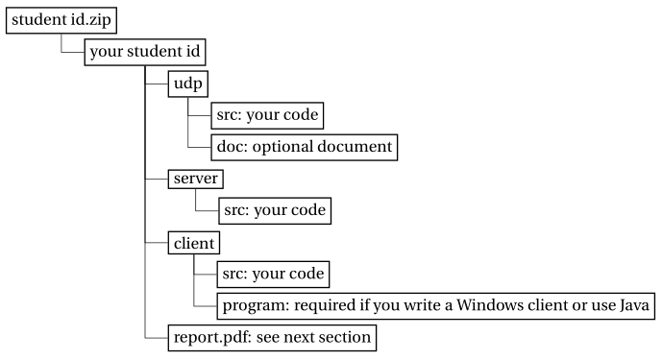
Some Important Issues
Submission
Source code for udp, server/client;
Executable file and how to run it;
Report: no longer than THREE pages.
Files are to be organized as follows:
Evaluation
Auto-grading program for FTP server.
Face-to-face check for FTP client.

Slide 31
Some Important Issues
Important Date
Start up: today (2022.9.28.)
Due date:
Stage 1: 2 weeks later (2022.10.12.)
Stage 2: 1.5 weeks later (2022.10.23.)

Slide 32
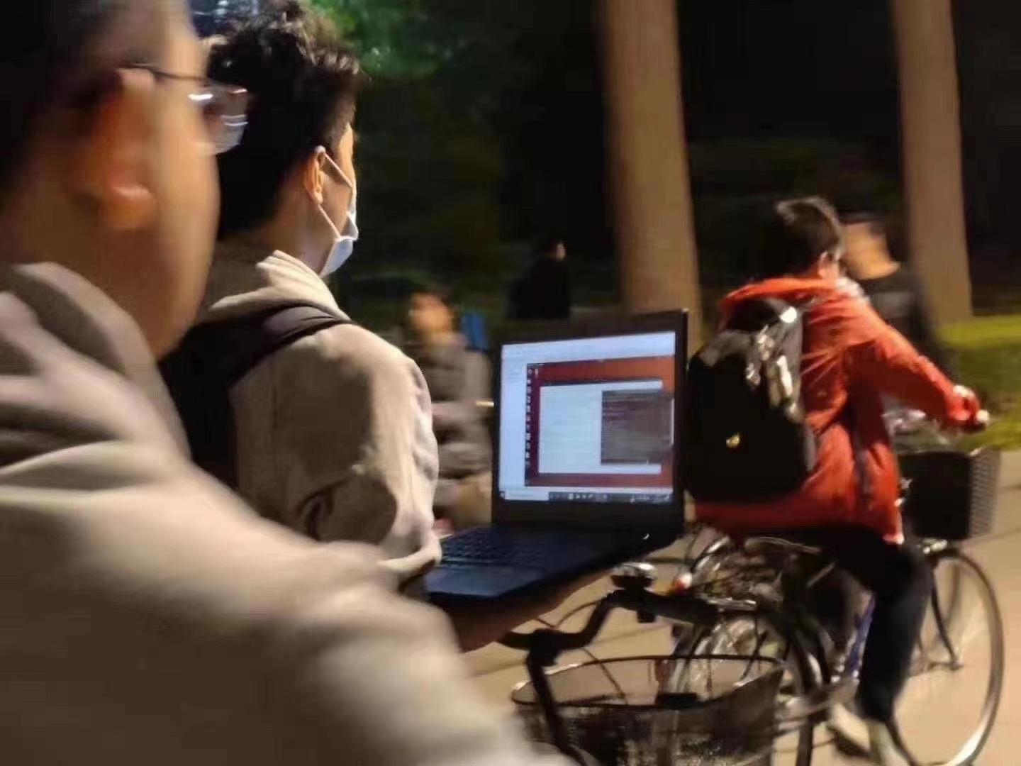
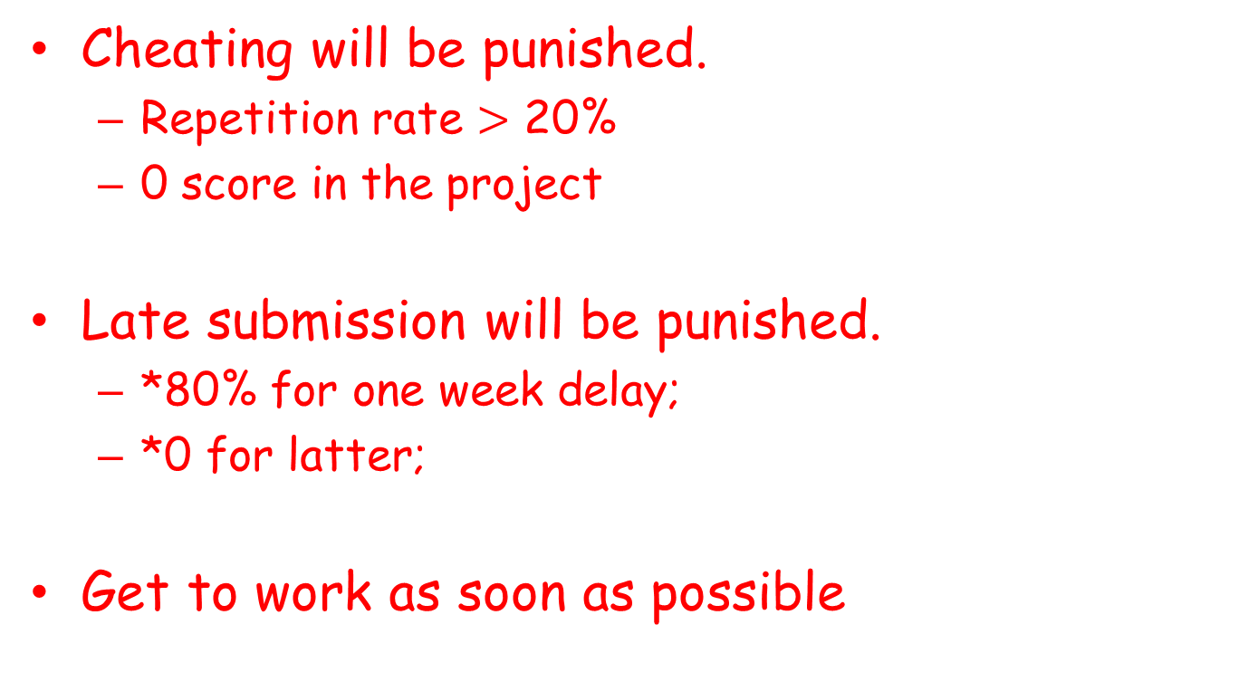
Some Important Issues
Cheating will be punished.
Repetition rate $>$ 20%
0 score in the project
Late submission will be punished.
*80% for one week delay;
*0 for latter;
Get to work as soon as possible

Slide 33
Problems Emerged
Improper use of control/data socket(list, pwd)
Illegal design of command (PORT/PASV)
Fails to connect to standard FTP server
Follow RFC protocol
Security Issue
cd ..
String Issue (\0)
Exceptions
Socket exception
I/O exception

Slide 34
How to implement an FTP?
Read RFC959 document;
Coding ON YOUR OWN;
Debugging;

Slide 35
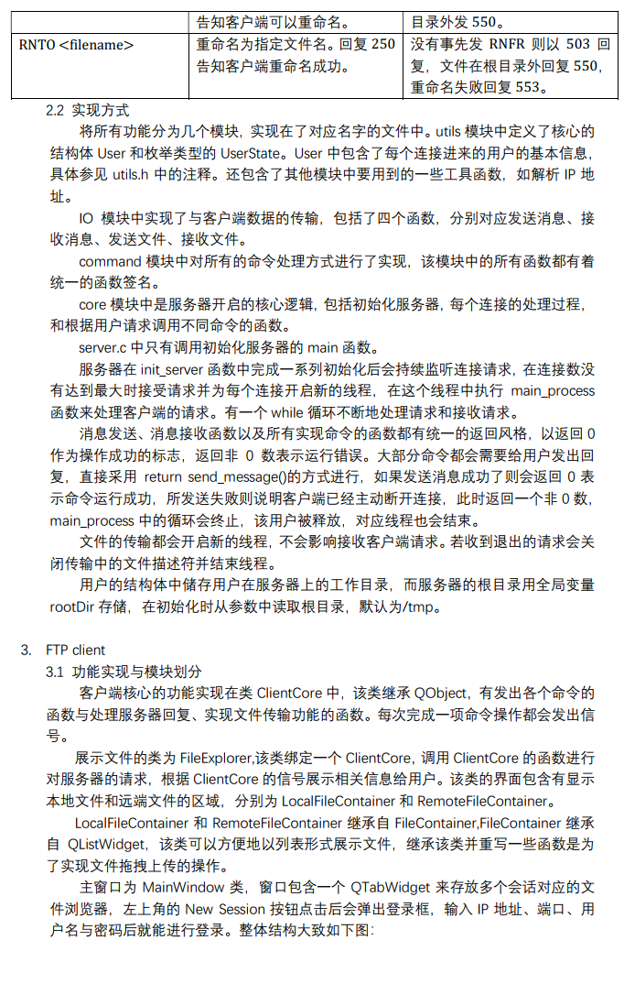
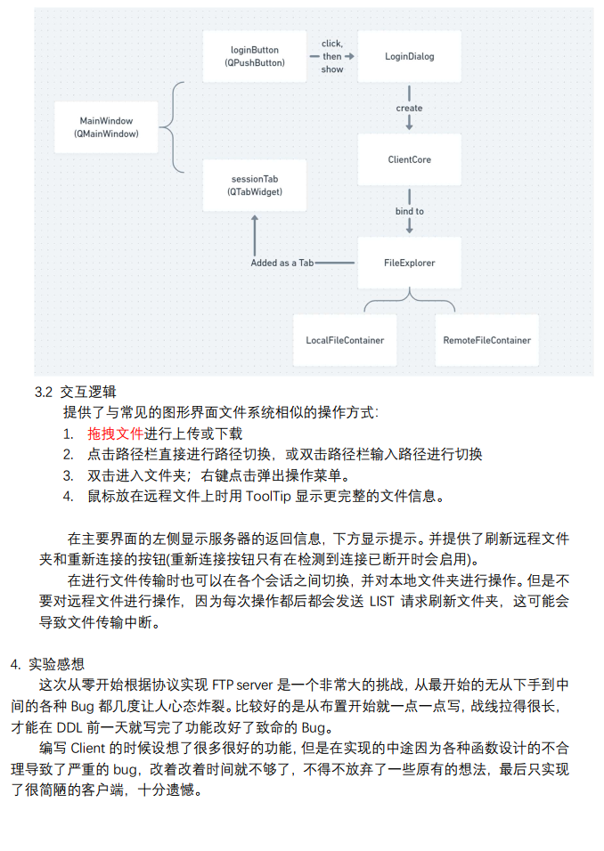
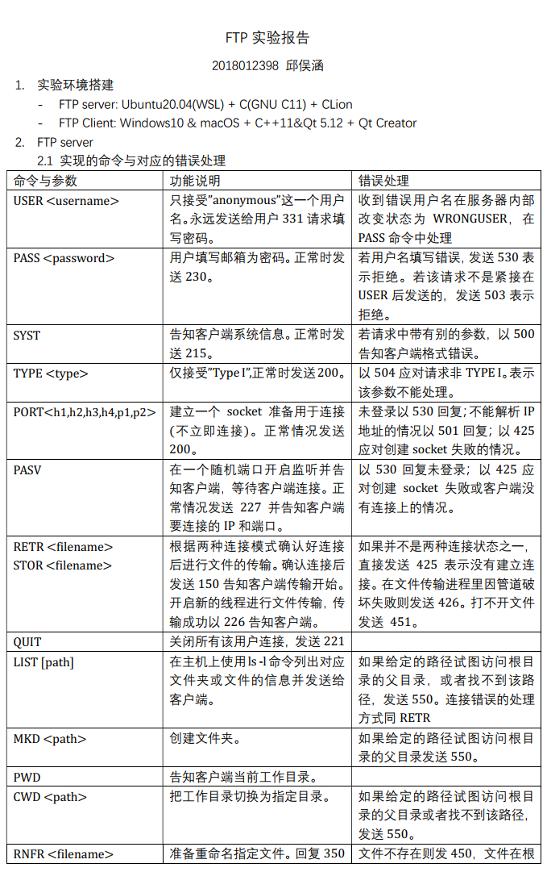
Previous Outstanding Project
Student A

Slide 36
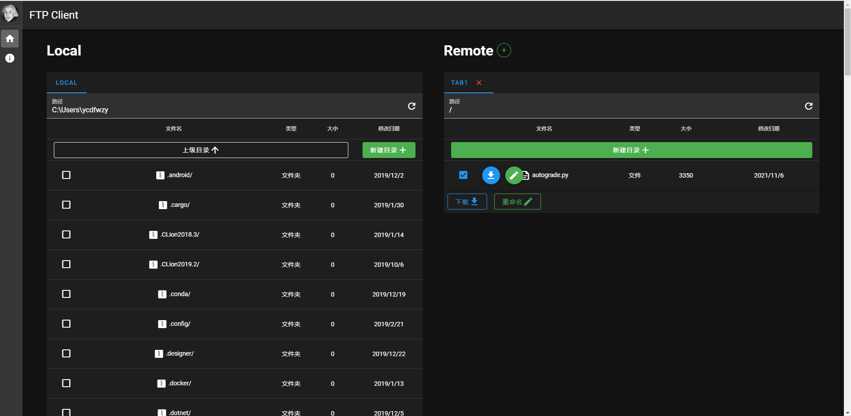
Previous Outstanding Project
Student B

Slide 37
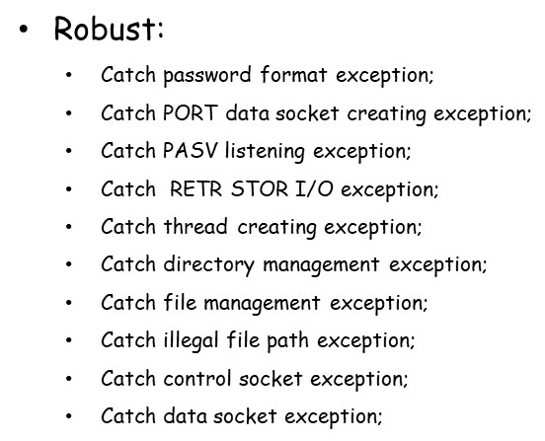
Previous Outstanding Project
Student C
Handle the following exceptions:

Slide 38
Happy National Day
Good luck

